Slide 1
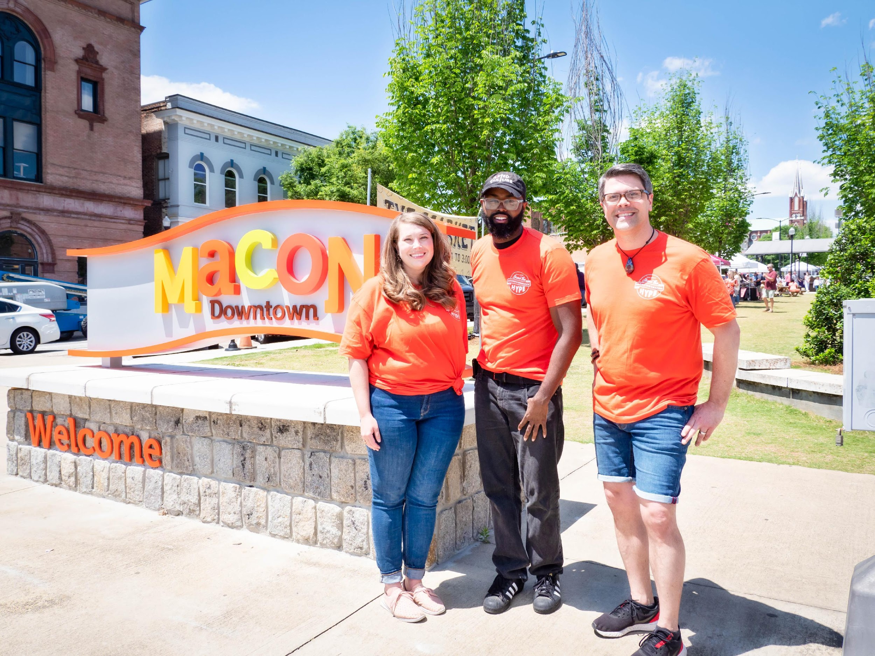
Downtown Macon Hype Team Orientation
April 14, 2022

Slide 2
Notes:
Who organizations are behind the Hype Team?
Program developed by NewTown’s Main Street board. Main Street is where all of NewTown’s placemaking and marketing efforts are funneled through.

Slide 3
Notes:
So we realized that public perception of downtown hadn’t caught up with the reality we’re experiencing today. We have a vibrant downtown with 55 Restaurants, 35 Music Venues and Bars, 4 Breweries, and 41 retailers. And that’s a reality that many people do recognize. We realized there were a lot of downtown cheerleaders out there. And we could mobilize folks like y’all to improve the downtown visitor experience and start to change an outdated perception by using local influencers. And that is how the Hype Team was born.

Slide 4
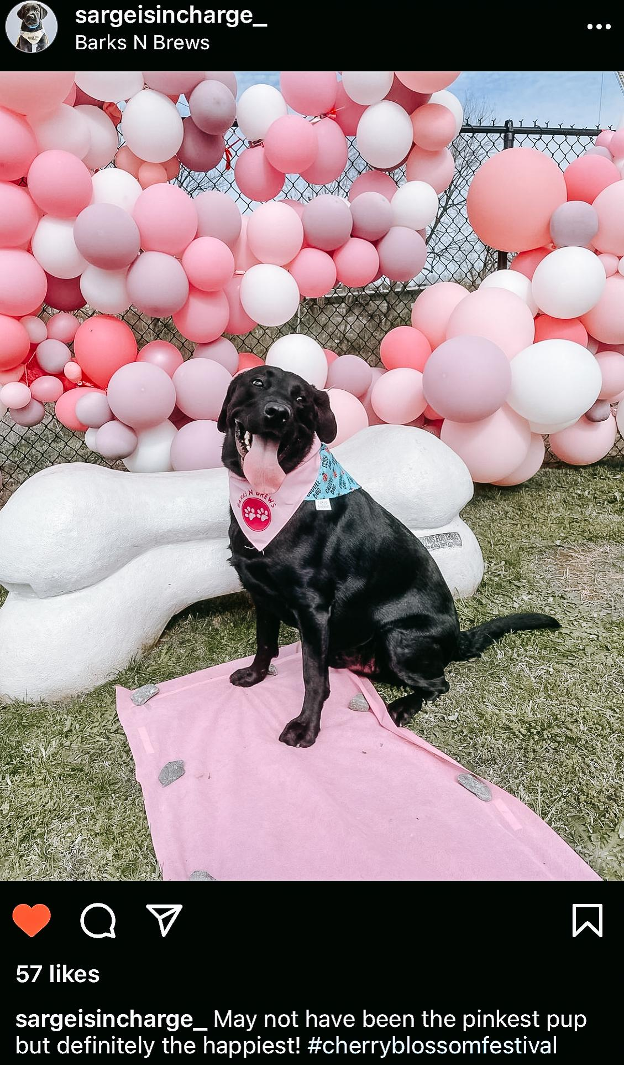
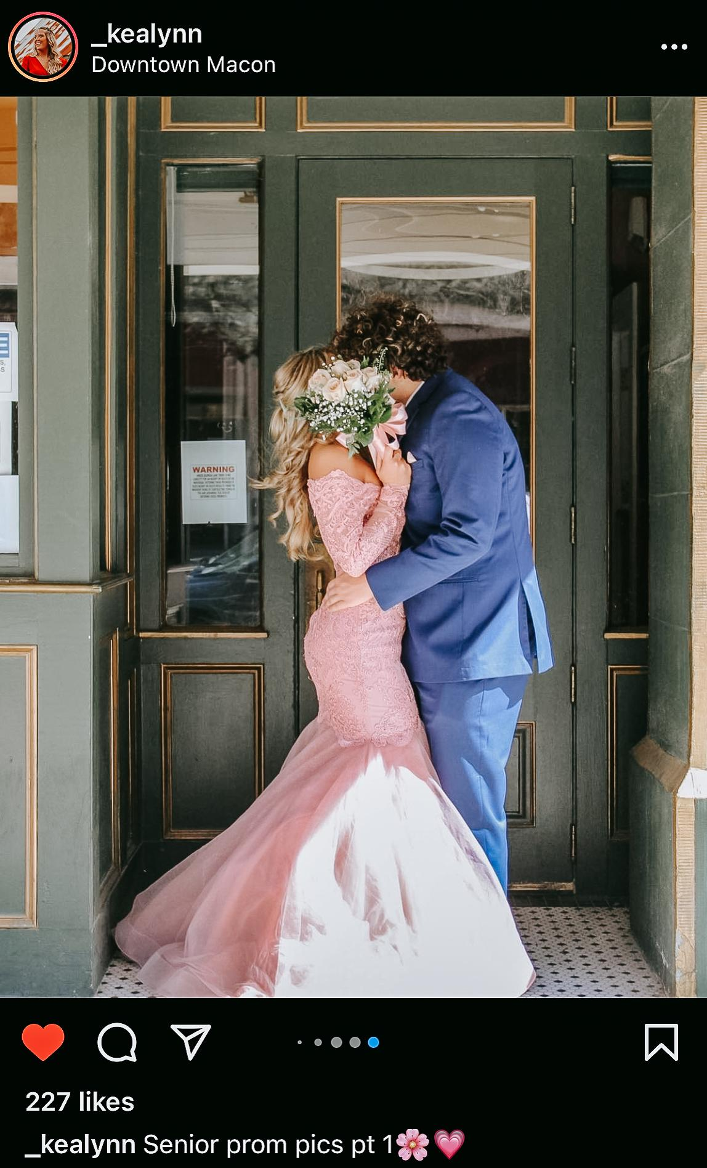
Notes:
Why was I selected to be on the Hype Team?
You were selected to be on the Hype Team because, besides showing interest, you showed that you’re excited and passionate about downtown and its progress. Each and every one of you had a different perspective about what makes downtown exciting and why you chose to visit downtown. We need and want all of those perspectives to help promote downtown to a wider audience and help our entire community see downtown as our community’s central gathering place.

Slide 5
What is the
Hype Team?
The Hype Team is composed of community members who share a passion for the progress happening in downtown and a desire to promote it.
Hype Team members serve as ambassadors during large events held in downtown Macon. They work as a united front to welcome visitors downtown, answer any questions visitors may have, and encourage people to use #downtownmacon when posting about their positive experience downtown.
Notes:
What is the Hype Team?
The Hype Team is a group composed of community members who share a passion for the progress happening in downtown and a desire to promote it. Hype Team members serve as ambassadors during large events held in downtown Macon. They work as a united front to welcome visitors downtown, answer any questions visitors may have, and encourage people to use #downtownmacon when posting about their positive experience downtown.
The Hype Team works as social influencers with a 100% positivity policy and encourages their network to visit downtown and make their friends, family, and acquaintances feel welcome downtown and as they belong.

Slide 6
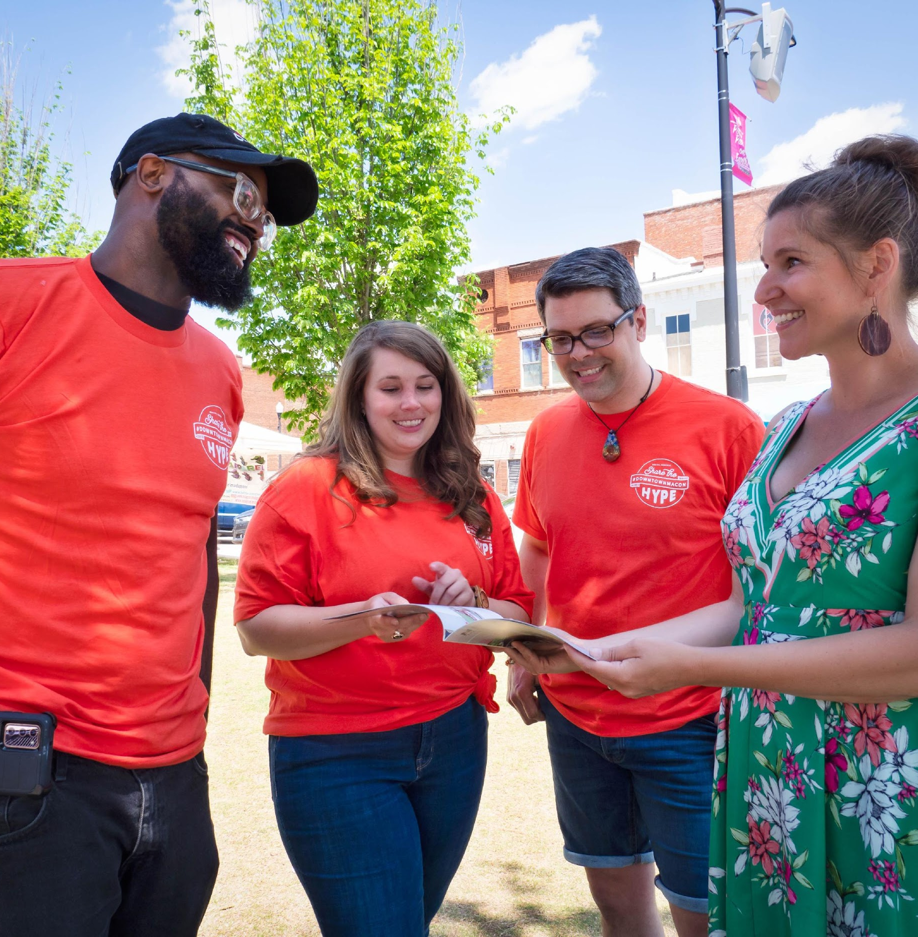
How does the Hype Team work?
Provide visitors with recommendations
Offer directions to visitors who seem lost
Provide assistance if someone has questions about the parking meters
Pass out swag and information to visitors
Notes:
How does the Hype Team work?
The way we achieve those things is by working as volunteers during major events held in downtown Macon. You’ll be charged with walking around downtown during your event shifts and interacting with visitors. You may be stopped by visitors when you’re out and asked for recommendations on places to eat or for recommendations. As you’re completing your shifts, we want you to be aware of the people around you. Look out for people who seem to be looking at their phone to figure out where something is –stop and ask them if they need directions or assistance. If you see people who seem confused about the parking meters, stop and ask them if they need help. During your volunteer shift, we’ll provide for things for you to pass out –like stickers for kids and information about the event you’re working. For example, during First Friday, we’ll provide handbills with a list of events. This will make it easier for you to engage with visitors and help people feel welcomed and like there are eyes and ears on the streets of downtown.

Slide 7
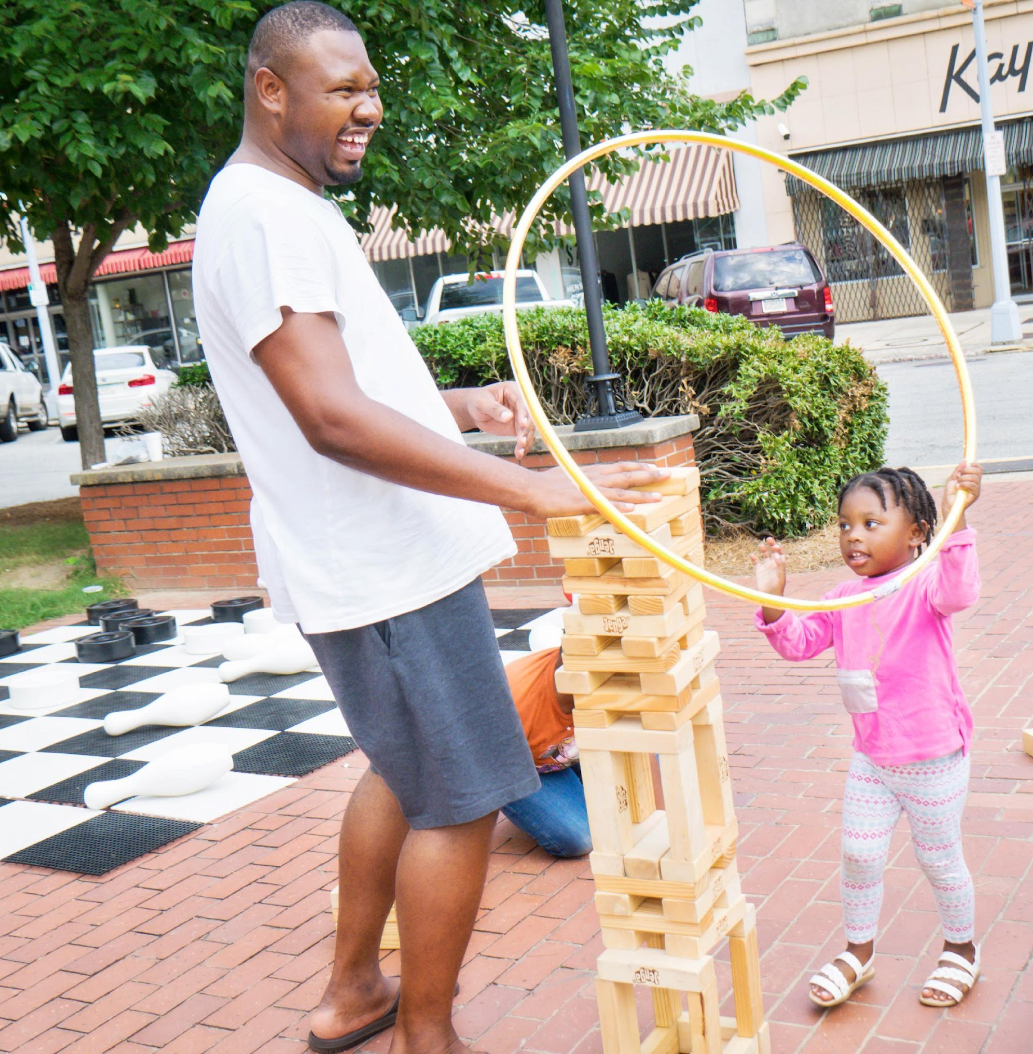
Hype Team Member Expectations
Sign up for volunteer shifts at least 1 week in advance of the event date
Volunteer for a 2-hour shift during 4 events annually
Arrive 15 minutes early to your shift
Be kind and courteous
Complete the Hype Team Member Commitment Form
Notes:
What are the expectations of Hype Team members?
Hype Team members are expected to volunteer for at least 2 two-hour shifts during events held downtown. Our Main Street Macon marketing committee has developed a list of those events for the rest of this year. Following this meeting, we’ll provide you with a sign-up link to select the events you want to work. We ask that you sign up for the events you want to work at least one week in advance of the event so that our marketing committee can be sure the events are covered adequately and prepare the information that is needed.
You are expected to arrive to NewTown Macon’s office 15 minutes prior to your event shift. This will give us time to brief you on what’s going on during the event and provide you with any materials you may need for working your shift.
We also expect everyone to be kind and courteous when interacting with visitors, other team members, and NewTown or Main Street’s staff and volunteers. When you are volunteering as a Hype Team member, you are an extension of downtown Macon’s brand. We want anyone who visits downtown Macon to leave feeling like they experienced exceptional hospitality and friendliness. We want to people to feel welcome and wanted and feel like they were able to navigate their downtown experience successful. Bottom line, we want them to leave Macon and go tell everyone how awesome Macon, and specifically our downtown area is.

Slide 8
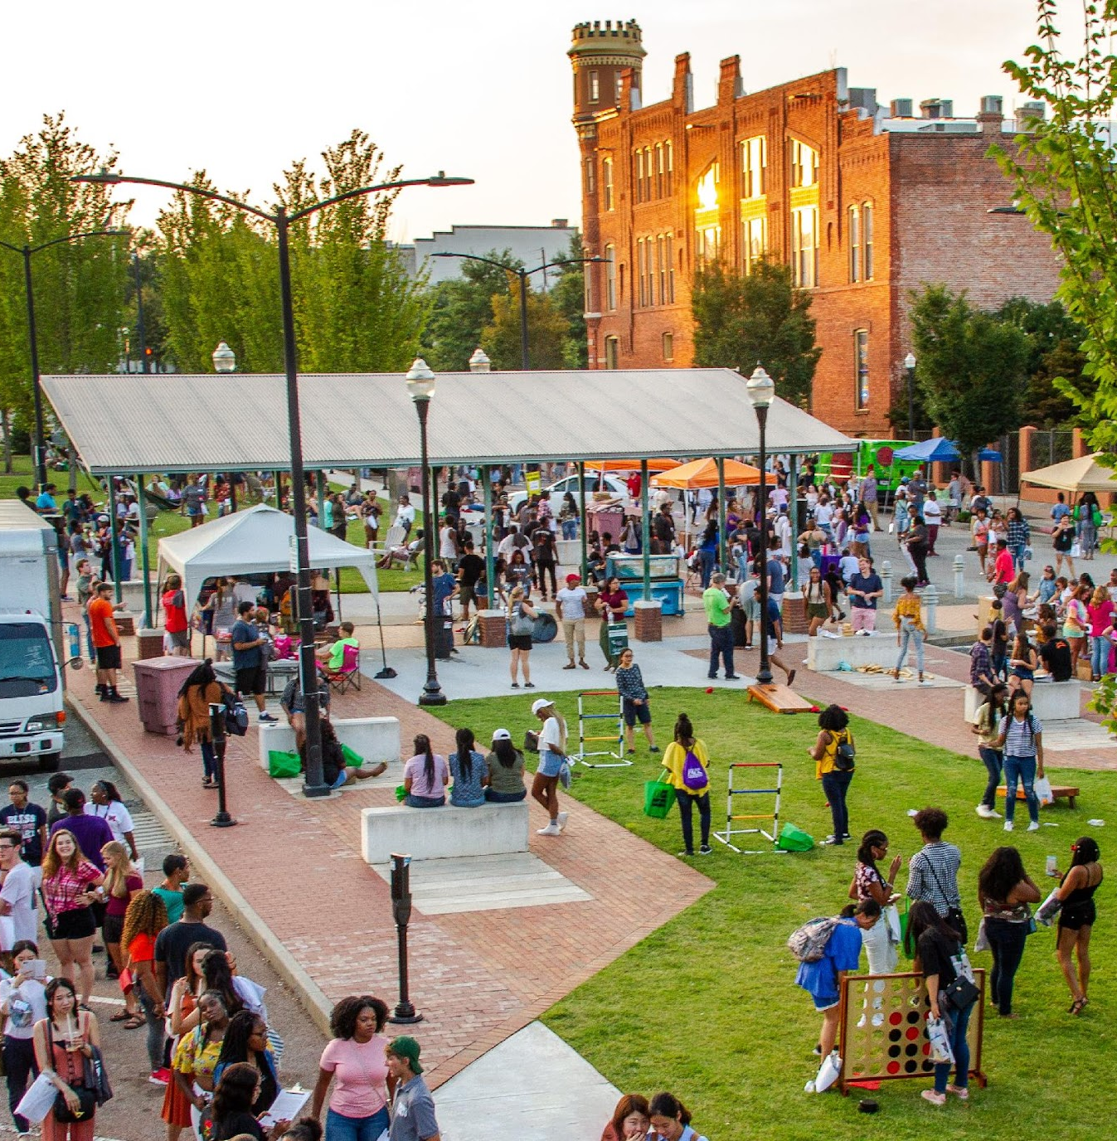
2022 Hype Team Events
First Fridays
The Market
Just Tap’d Beer Fest
Macon Beer Festival
Macon Pride
Tour of Progress
Trick-or-treat in Downtown Macon
Main Street Christmas Light Extravaganza
*Some events may be added in December
Notes:
What events will I work on the Hype Team?
Our marketing committee has identified the major events happening in the downtown area for the rest of the year. Those are things like First Friday, our monthly market, trick-or-treating, and Macon Pride. Events have to involve multiple businesses and benefit downtown as a whole, rather than 1 single business or organization.

Slide 9
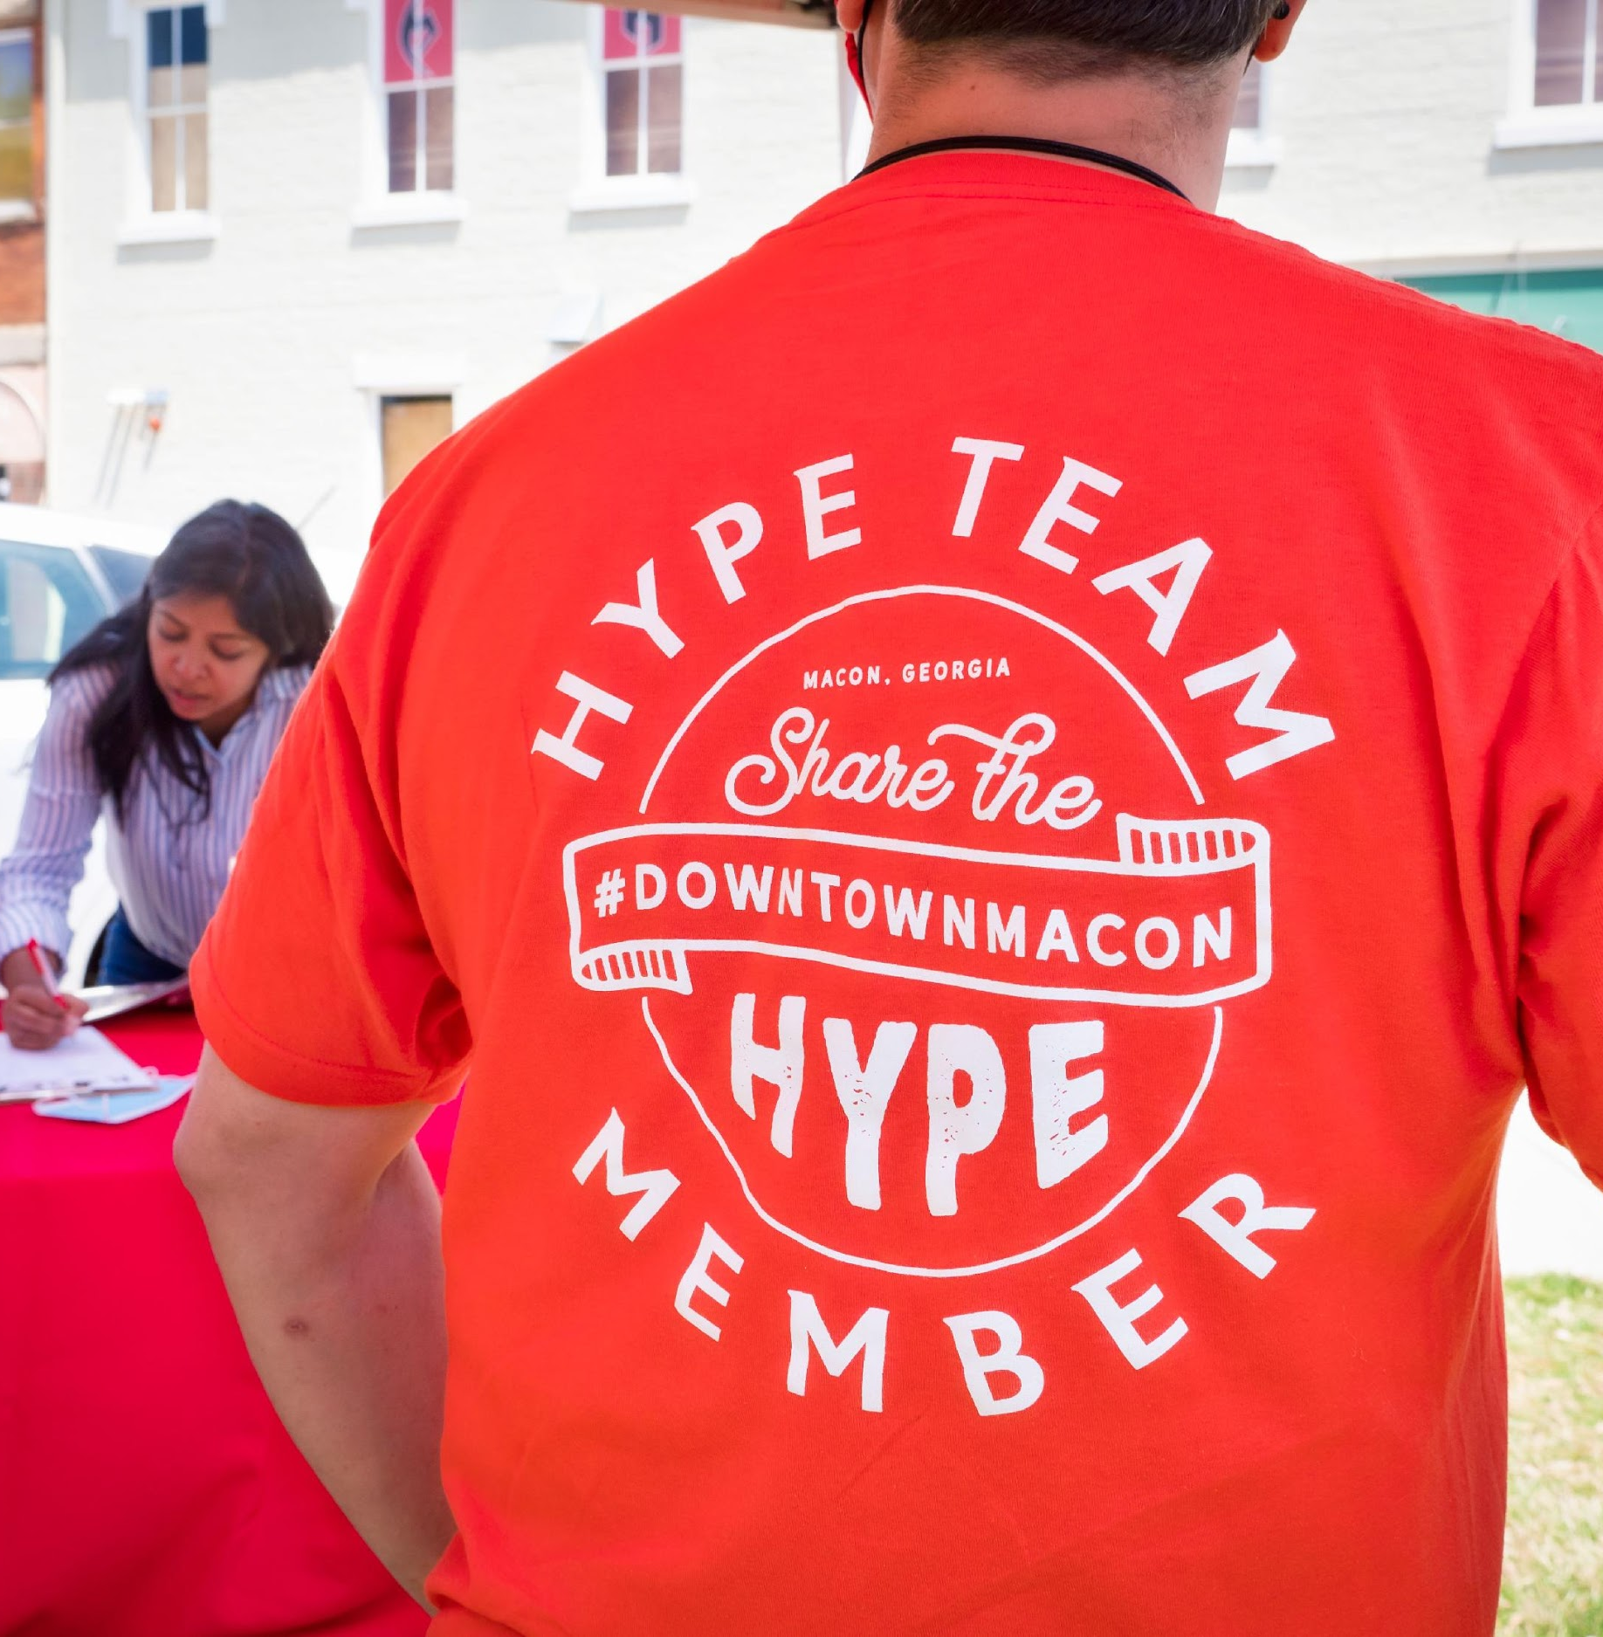
Hype Team Attire
Hype Team Tee!
Jeans and shorts are acceptable to wear with your t-shirt
Comfortable shoes for walking
Do not wear any buttons or stickers that display or promote political affiliations
Notes:
What do I wear?
You will be provided a Hype Team t-shirt at your very first event shift which you should wear while completing your volunteer duties that night. The Hype Team is really casual, so whatever you feel comfortable wearing with your shift is fine. Jeans, shorts, a skirt, all of that is acceptable. We’ll also provide nametags for all of you.
When wearing your shirt, we want you to remember you’re an extension of that downtown brand. So please be mindful of that and reframe from doing things like cussing, rude gestures, etc.
Please do not wear your shirt when you’re not completing you Hype Team duties. Think of this as a work uniform.

Slide 10
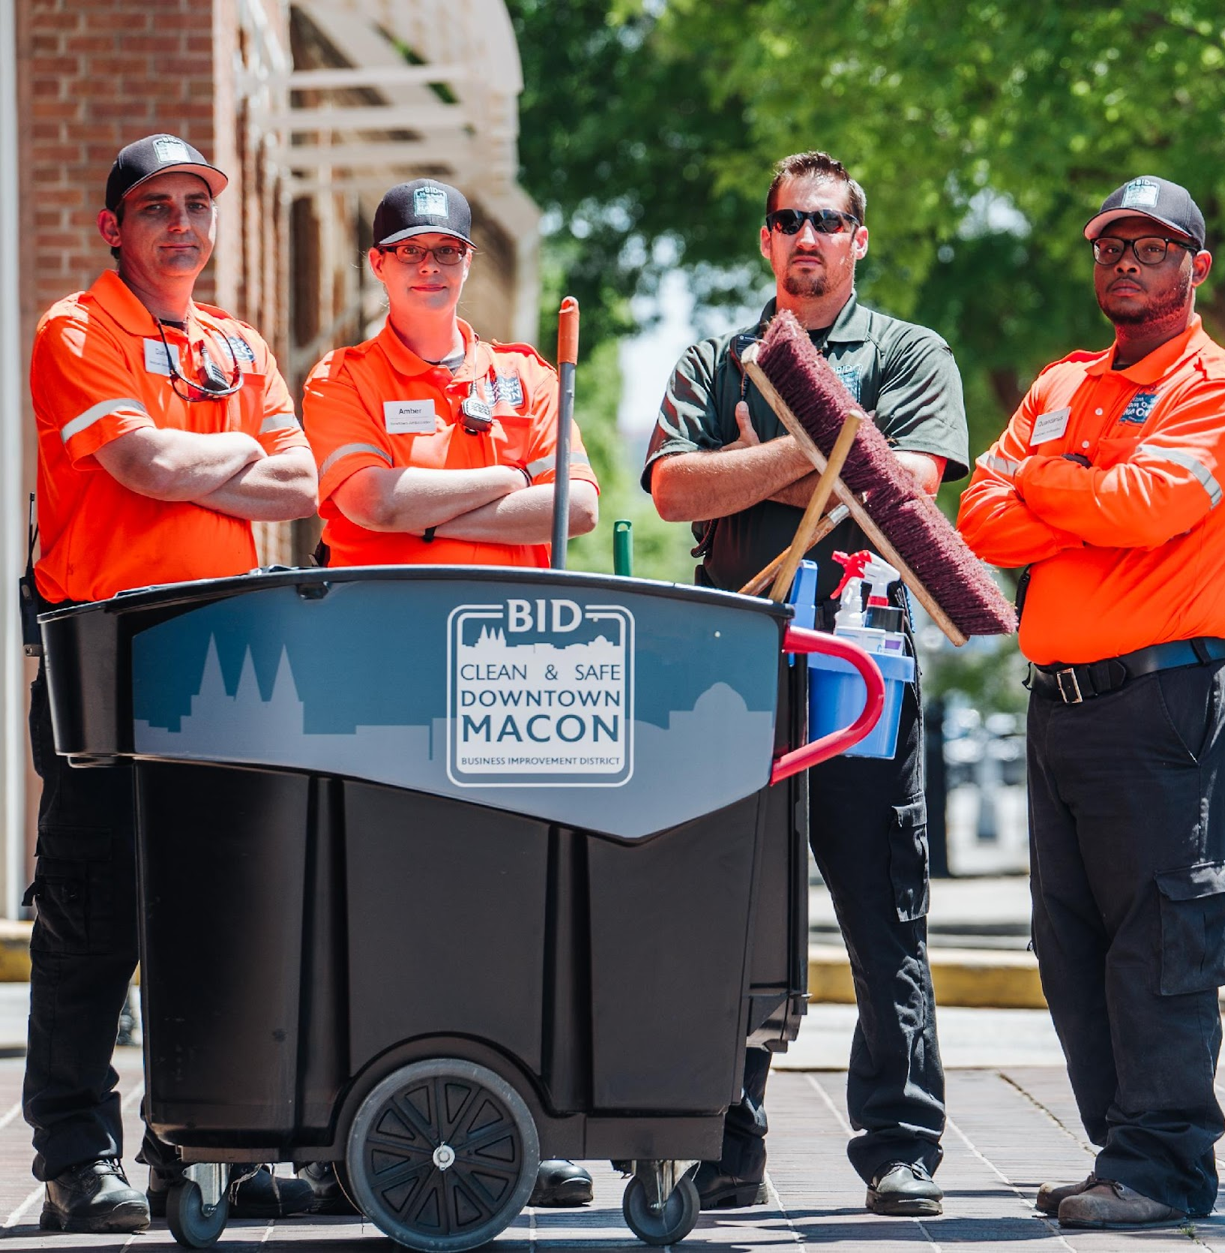
Safety Protocol
Team members will fulfill duties in pairs
Team members will be provided with phone numbers of downtown emergency response groups at the beginning of each shift:
BID security staff
Off-duty officer hired by BID (if applicable)
BSO non-emergency number
Notes:
Will I be safe when fulfilling my duties?
To ensure the safety and comfort all team members, 2 team members will be paired together for each shift. No one member will walk around by themselves. We will also provide you with emergency phone numbers at the beginning of each shift just in case you may need them.

Slide 11
Frequently Asked Questions
Parking
The Dempsey
Those Experiencing Homelessness
Notes:
How do I answer hard questions?
As I mentioned earlier, the Hype Team was born out of the idea that people’s negative perceptions of downtown. There will always be things folks are critical of or don’t like. Three issues that we see frequently come up are parking, the Dempsey, and those experiencing homelessness. If someone asks you about these things while you are working as a volunteer, we ask that you respond in these ways:
It is really important for us to be on the same page in this regards. And I encourage all of you if you’re posed these questions to keep your answers simple. You don’t have to elaborate on these points and if you don’t feel comfortable answering the questions asked, you can always say, I really don’t know the answer to that question but I can find out for you. Or direct them to NewTown Macon. Tell them to send us a Facebook message or email downtown@newtownmacon.com to

Slide 12
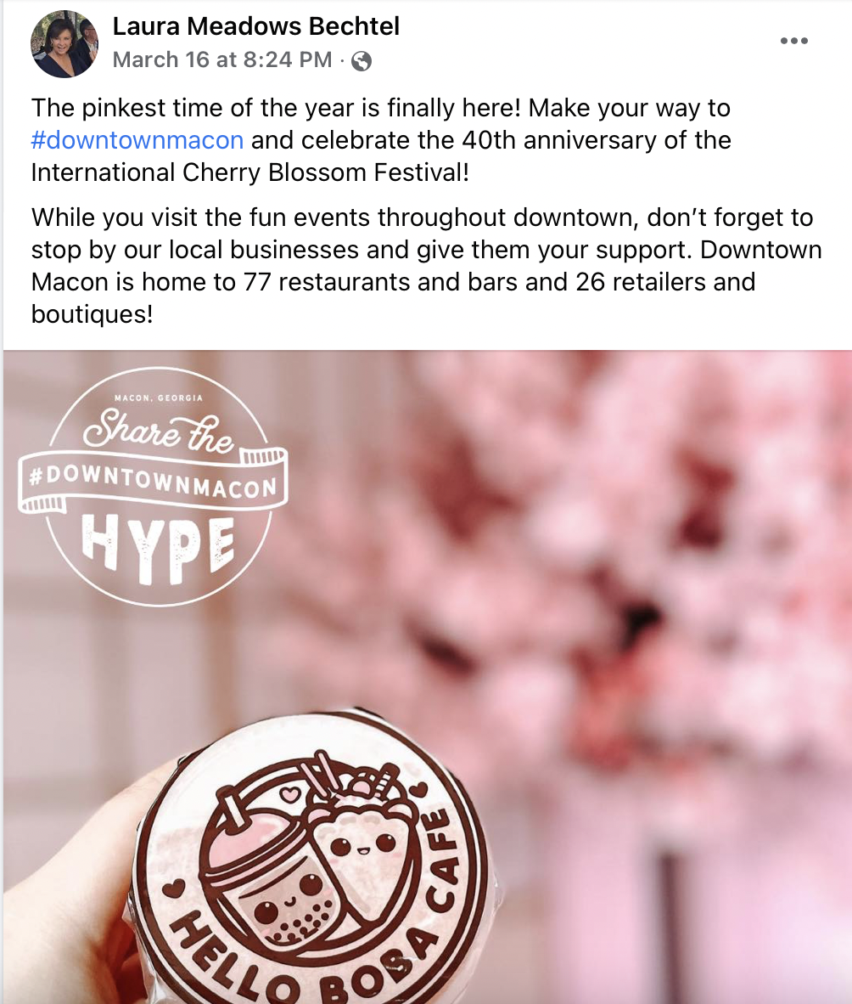
Social Media
Social media participation is optional
Must sign and adhere to social media policy if you opt into social media participation
If you opt in, you agree to the 110% positive social media policy
You’ll be provided with weekly posts to share on your social media platforms
Notes:
Review social media policy –totally optional but we encourage all Hype Team members to follow this or think about it when posting, even if they opt out.

Slide 13
Follow NewTown Macon
Instagram: @newtownmacon
Facebook: NewTown Macon
Follow Downtown Macon
Instagram: @downtownmaconga
Facebook: Downtown Macon
TikTok: @downtownmacon
Notes:
How do I stay connected with other Hype Team members?
We have created a Facebook group for the Hype Team. We’ll start sending invites to y’all to join that early next week. We’ll post any updates we need to share there. We also encourage you to connect with one another and share cool things you see happening downtown.
And of course we’ll send email updates as well. So if you need to update your email, let me know that.

Slide 14
Thank you Visit Macon!

