Slide 1

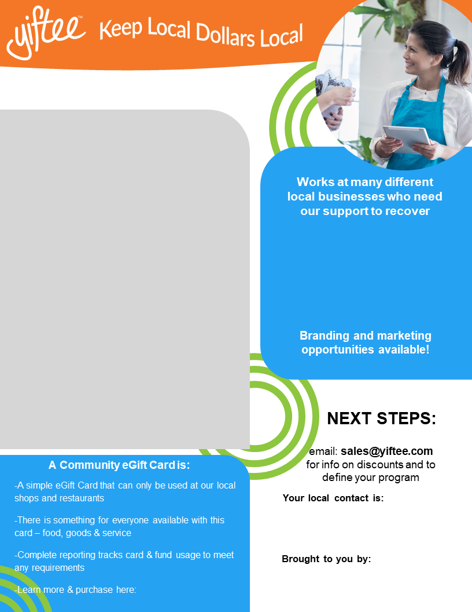

August is Black Business Month!
Show your support for local Black Owned Businesses
Fund a Buy-One-Get-One promotion where bonus
cards feature Black Owned Businesses:
This is a great way to engage your community in the Shop Local movement, generate much needed foot traffic and get money directly to your local businesses. We’ve seen up to 8X ROI with these promotions.
With just $10,000, you’ll have a wildly positive impact on your local economy and Black Owned Businesses in particular. In exchange for your generosity, we can have your company logo on our gift card page, bonus card image and social media posts as well as include your company name in any press and promotional materials.
Purchase gifts for your employees:
Reward your employees for their hard work, while also encouraging them to support local Black Owned Businesses, by gifting them the Your Gift Card Name Here. No Fees on your purchase, plus you’ll get a free account where you can send gifts whenever you’d like and run reports.
Your card image here
Name and title yourname@youremail.com
Your logo here
Your organization
name here
Your community card URL

