Slide 1
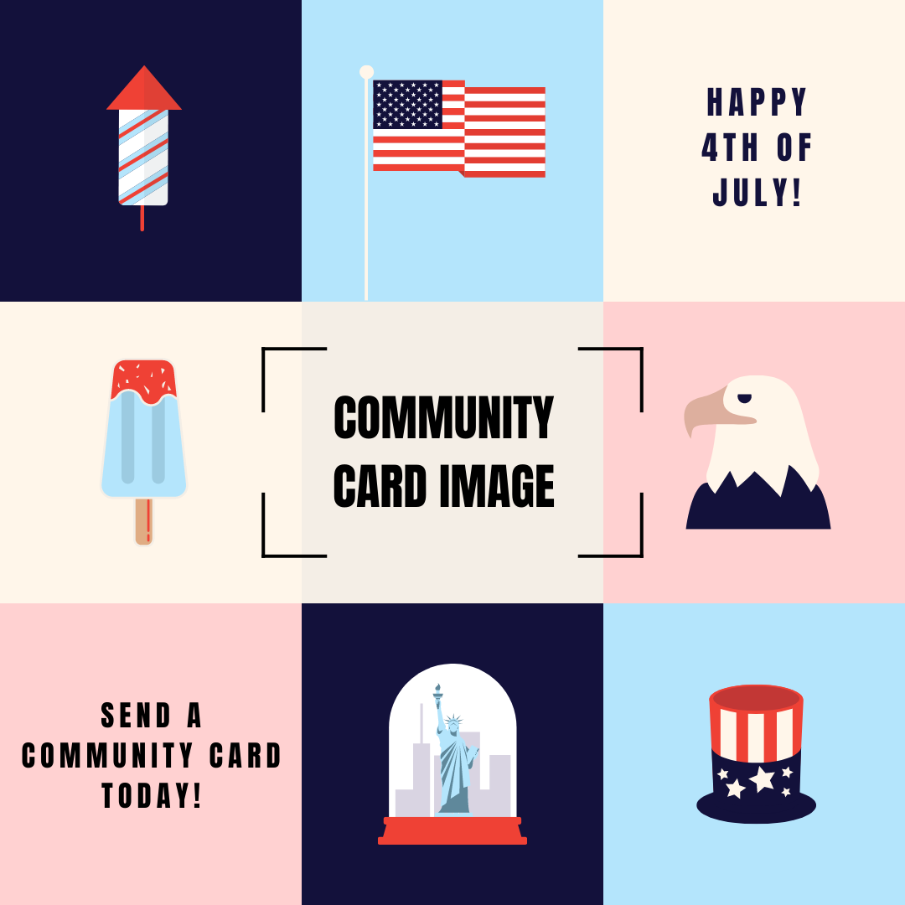

Slide 2
CELEBRATE BY SENDING A _______ COMMUNITY CARD

Slide 3
SUPPORT BLACK OWNED BUSINESSES BY SENDING A _______ COMMUNITY CARD

Slide 5
SHOW YOUR APPRECIATION BY GIFTING A
_______ COMMUNITY CARD

Slide 6
CELEBRATE YOUR ROOTS WITH A _______ COMMUNITY CARD

