Slide 1
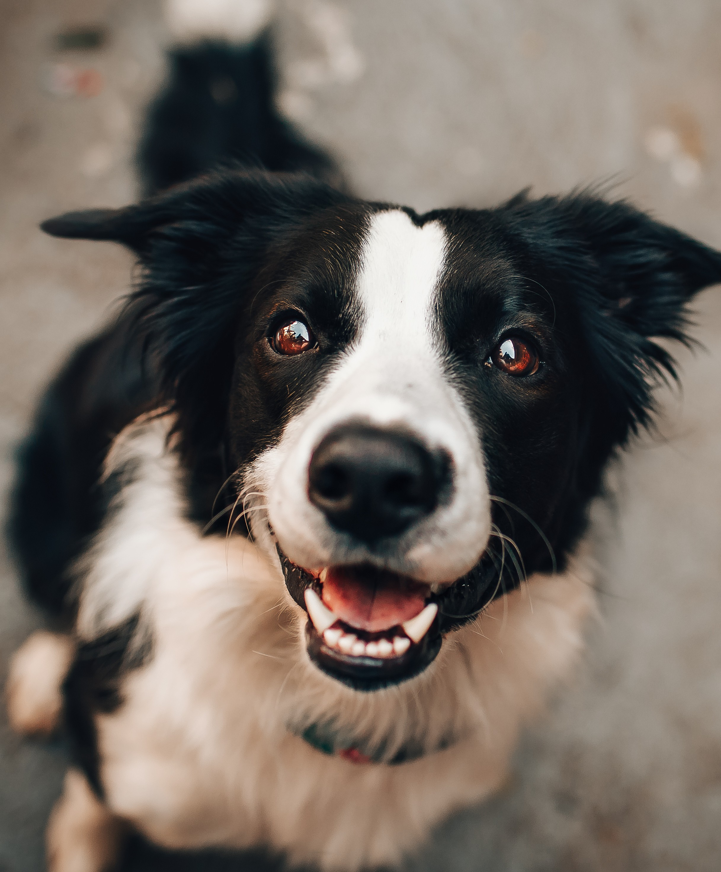
Did you know?
DOGS IMPROVE YOUR HEALTH.
Having one as a pet can help lower your blood pressure!
Use your [COMMUNITY] card here to show your furry companion love with a grooming they will never forget!

Slide 2
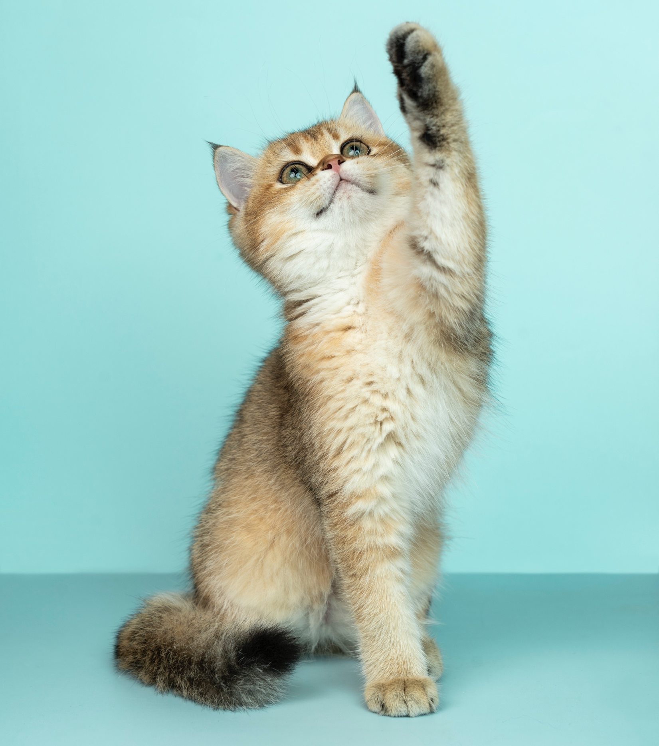
WE LOVE CATS!
WE ALSO LOVE THE…
USE IT AT
FELINE FUZZ PET STORE
Nutrition, grooming, and accessories for your cat!

