Slide 1
SUPPORT SMALL BUSINESSES WITH THE
Baked with Love
Come in and use your [Community] Card today!

Slide 2
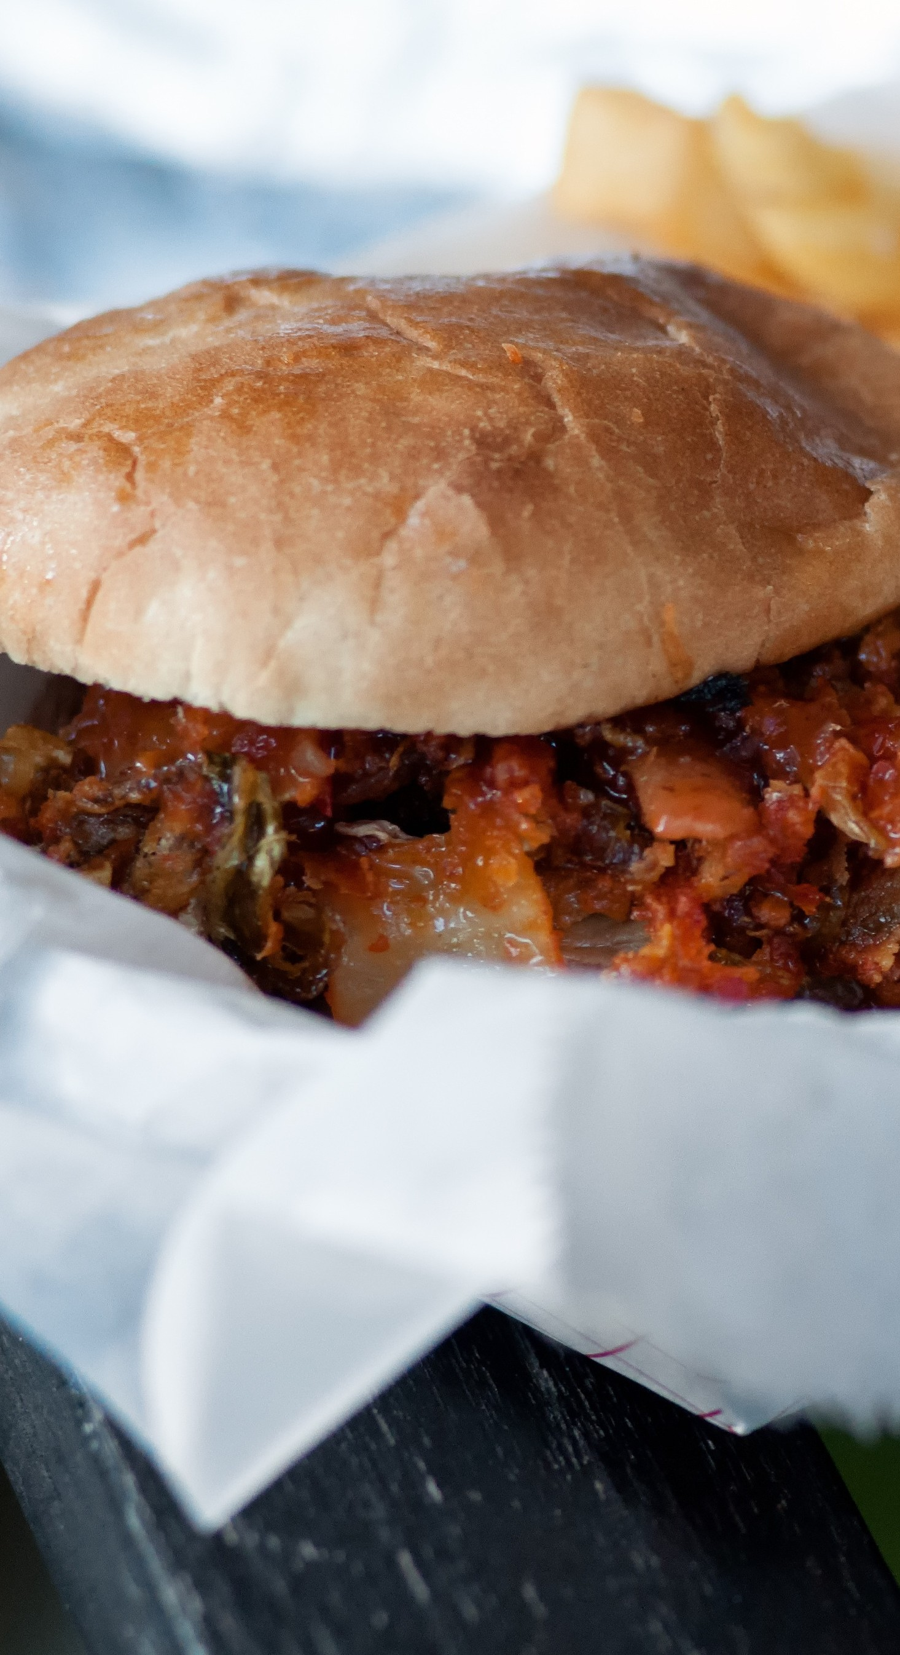
AT ROAST ITALIAN BISTRO, WE ACCEPT THE
Enjoy Fridays by supporting local businesses like ours!

