Slide 1
Support your local economy
GET A COMMUNITY eGIFT CARD!

Slide 2
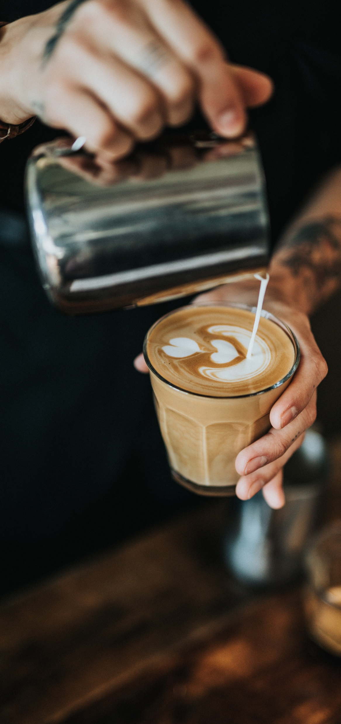
SHOP SMALL,
SHOP LOCAL
USE YOUR [COMMUNITY] CARD TO BUY YOUR MORNING CUP!
The best cup of coffee is waiting for you.

Slide 3
The Stockton Cafe
Date night just got better…
Support all your local businesses with
one card!

